Slide 1
Public Works Improvements Arts Program: Economic & Social Impact
By:
David Eng
Craig Kodish
Ryan Moore
Stephanie Ngo
Paul Vu

Slide 2
Project Overview
Provide data visualization for economic outcome and impact of PWIAP by zip code against three key performance indicators:
Median Home Price
http://files.zillowstatic.com/research/public/Zip/Zip_Zhvi_AllHomes.csv
What is ZHVI?
Each Zillow Home Value Index (ZHVI) is a time series tracking the monthly median home value in a particular geographical region. In general, each ZHVI time series begins in April 1996. We generate the ZHVI at seven geographic levels: neighborhood, ZIP code, city, congressional district, county, metropolitan area, state and the nation.
http://www.zillow.com/research/zhvi-methodology-6032/
Average Rent Price
http://files.zillowstatic.com/research/public/Zip/Zip_Zri_AllHomesPlusMultifamily.csv
What is ZRI?
Similar to the ZHVI, Zillow Rent Index (ZRI) was created to track the monthly median rent in particular geographical regions. Like the ZHVI, Zillow sought to create an index for rents that is unaffected by the mix of homes for rent at any particular time.
https://www.zillow.com/research/zillow-rent-index-methodology-2393/
Crime Rate

Slide 3
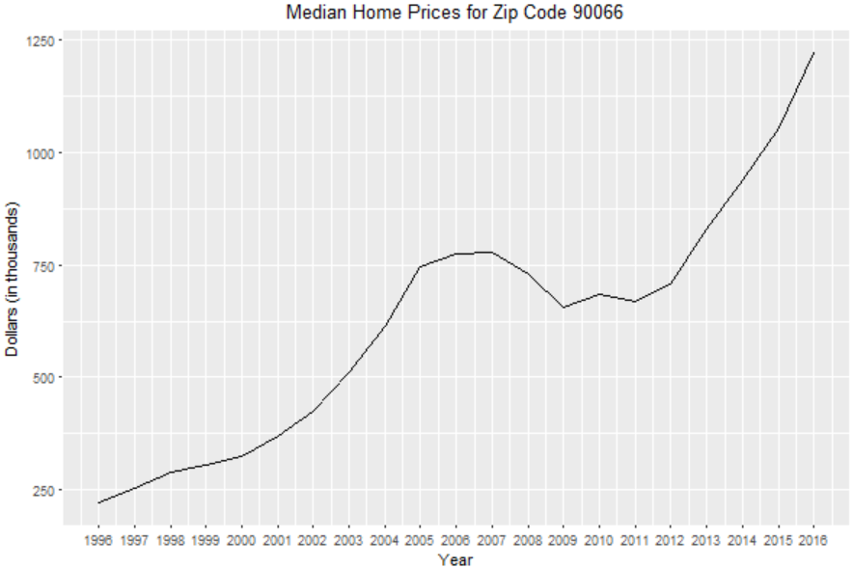
KPI 1: Median Home Price
Input:
ZHVI
Years
Zip code
Output:
Y-axis: ZHVI
X-Axis: Years

Slide 4
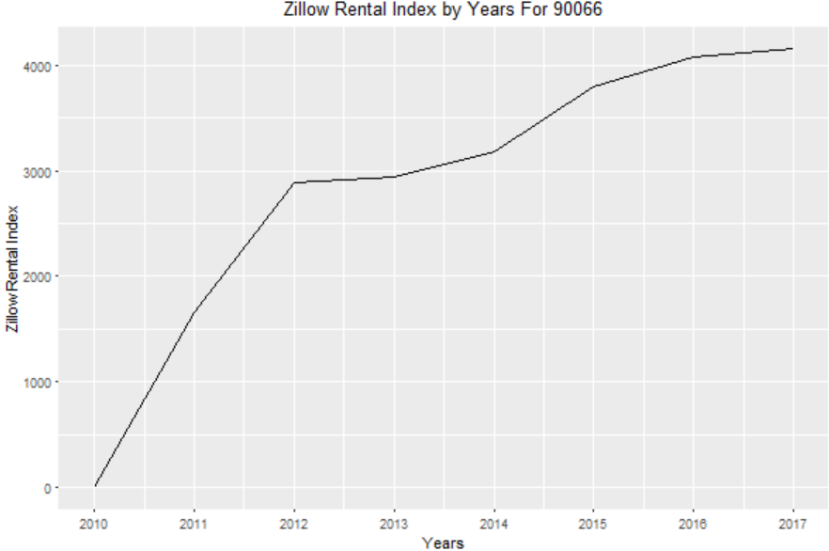
KPI 2: Average Rent Price
Inputs: Zillow Median Rent
ZRI
Zip code
Years
Output:
Y-Axis: ZRI
X-Axis: Years

Slide 5
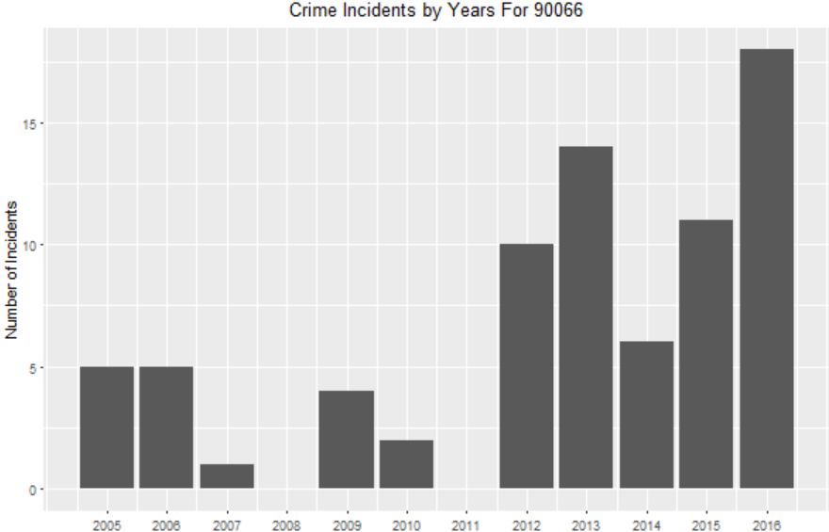
KPI 3: Local Crime Rate
Inputs:
Year
Zip Code
Output:
Y-Axis: Number of Incidents
X-Axis: Years

Slide 6
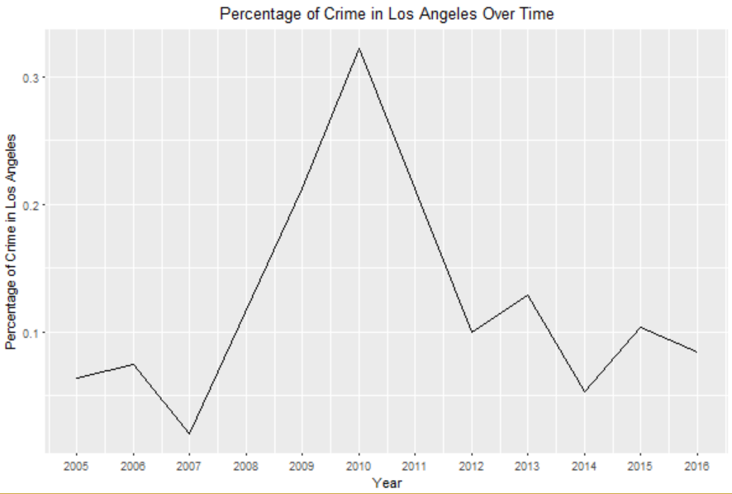
KPI 4: Crime Rate Percentage of LA
Inputs:
Year
Zip Code
Criminal Incidents
Output:
Y-Axis: Zip Code Incidents as a Percentage of Total Incidents in LA
X-Axis: Years

Slide 7
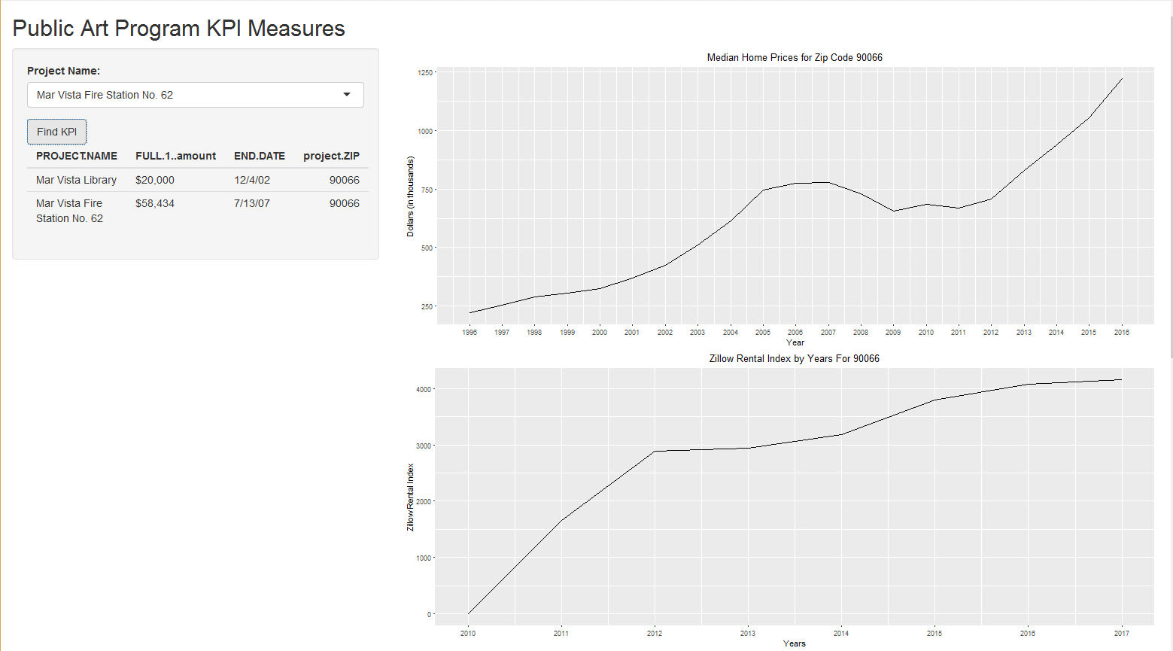
Proposed Dashboard (Page 1 of 2)

Slide 8
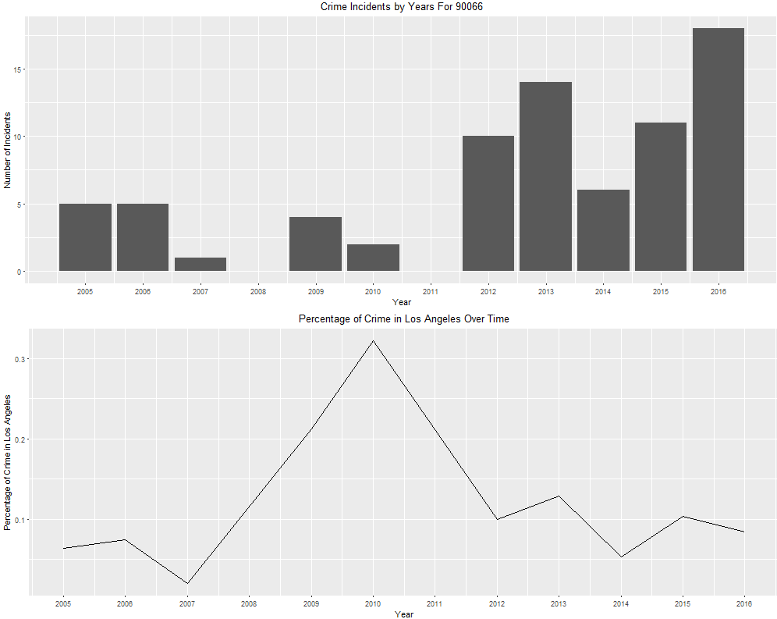
Proposed Dashboard (Page 2 of 2)

Slide 9
Questions?

